Slide 1

Computational Physics (PHYS6350)
Lecture 17: Random numbers
Reference: Chapter 10 of Computational Physics by Mark Newman
March 27, 2025
Instructor: Volodymyr Vovchenko (vvovchenko@uh.edu)
Course materials: https://github.com/vlvovch/PHYS6350-ComputationalPhysics

Slide 2
(Pseudo-)random numbers
Random numbers play important role, both in modelling of the physics processes (some of which are regarded as truly random, such as radioactive decay) and as a tool to tackle otherwise intractable problems.
Examples:
Numerical integration (especially in many dimensions)
Sampling microstates in statistical mechanics
Simulating quantum processes
Monte Carlo event generators
Numbers generated on a computer are usually not truly random, but a good generator produces numbers that reflect the desired properties of a random variable, hence it is called pseudo-random number generator.

Slide 3
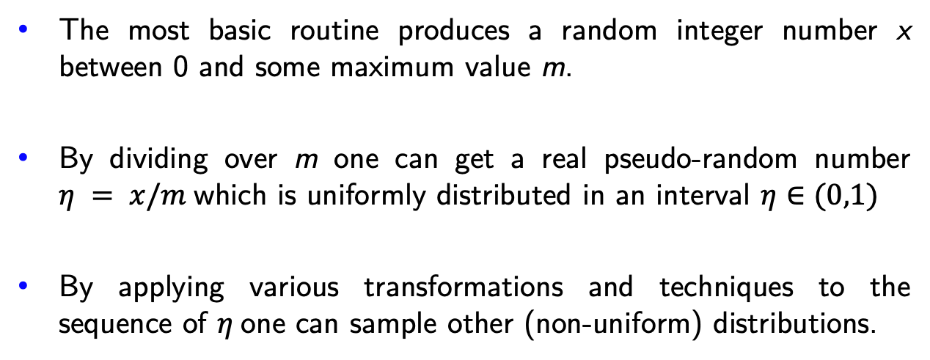
Pseudo-random numbers on a computer
The most basic routine produces a random integer number x between 0 and some maximum value m.
By dividing over m one can get a real pseudo-random number $η = x/m$which is uniformly distributed in an interval $η∈(0,1)$
By applying various transformations and techniques to the sequence of $η$one can sample other (non-uniform) distributions.
How to sample pseudo-random numbers x?

Slide 4
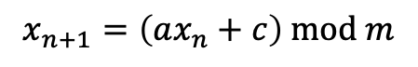
Linear congruential generator
Historically, one of the simplest RNG is linear congruential generator (LCG)*.
It generates a sequence of pseudo-random numbers in accordance with an iterative procedure
$$x_{n+1}=\left(ax_{n}+c\right) mod m$$
for some parameters a, m, x₀.
The next number in a sequence depends only on the present one.
The sequence is periodic with a period of at most m
*Do not use LCG in any serious calculation(!)
C++:
avoid using rand()

Slide 5
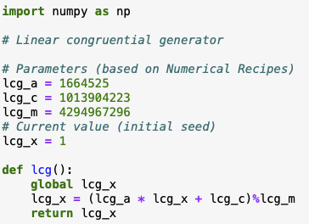
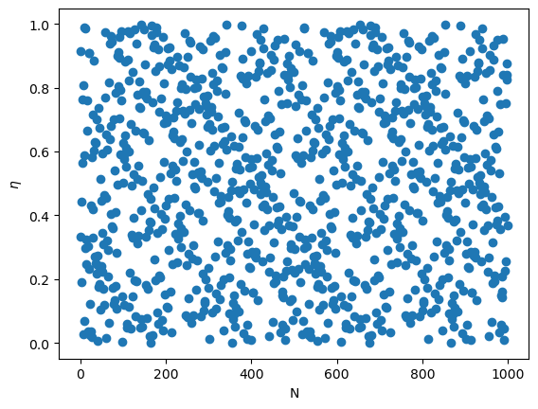
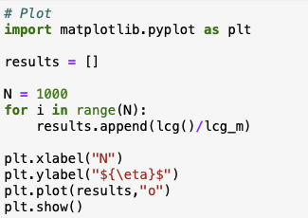
Linear congruential generator: Example

Slide 6
Linear congruential generator
LCG has some serious drawbacks:
Apart from a rather short period, it also fails many statistical randomness tests.
For instance, if one regards random numbers as components of a vector (x,y,…), the method tends to generate these points on a hyperplane (spectral test).

Slide 7
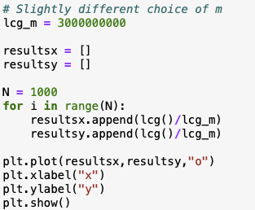
Linear congruential generator
LCG has some serious drawbacks:
Apart from a rather short period, it also fails many statistical randomness tests.
For instance, if one regards random numbers as components of a vector (x,y,…), the method tends to generate these points on a hyperplane (spectral test).

Slide 8
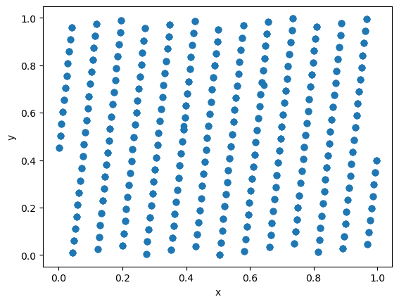
Linear congruential generator
LCG has some serious drawbacks:
Apart from a rather short period, it also fails many statistical randomness tests.
For instance, if one regards random numbers as components of a vector (x,y,…), the method tends to generate these points on a hyperplane (spectral test).

Slide 9
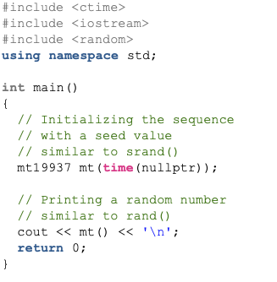
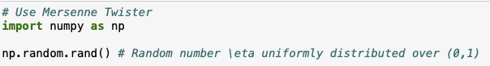
Mersenne Twister
LCG is not and should not be used in any serious calculations.
Other methods have been developed over the years and the general method of choice is Mersenne Twister random number generator which is implemented by default in many programming environments.
MT has a long period of 2¹⁹⁹³⁷ - 1, passes most statistical randomness tests, fast, and suitable for most physical applications (except cryptography).
It now implemented by default in many languages and we will take it for granted.
Python:
C++ (since C++11):

Slide 10
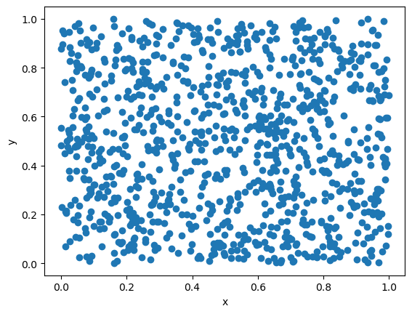
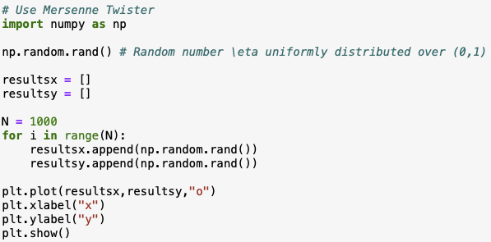
Mersenne Twister

Slide 11
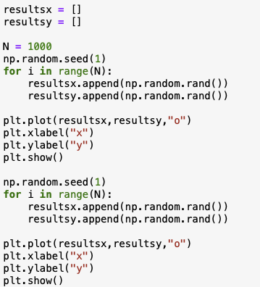
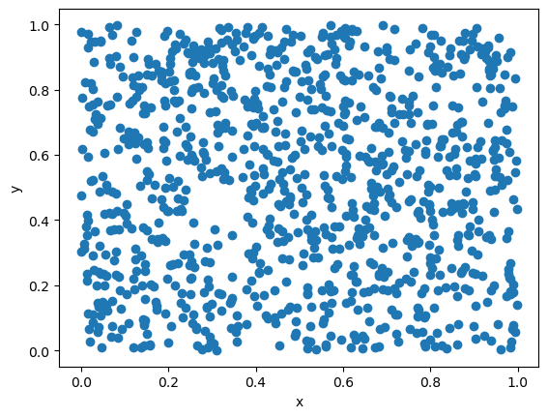

Random seed
Most RNGs (like LCG, Mersenne Twister,…) maintain state variables and
iteratively generate a pre-determined sequence of (pseudo)-random numbers
The initial state can be changed by specifying the seed
Running the program from the same seed will generate identical outcome
Using the same seed is good for debugging… but bad for parallel production runs on a cluster

Slide 12
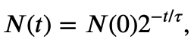
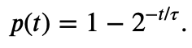
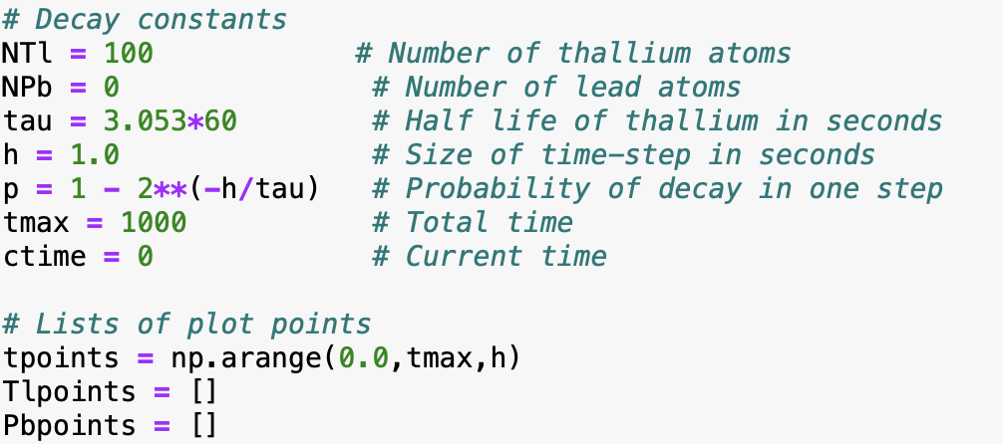
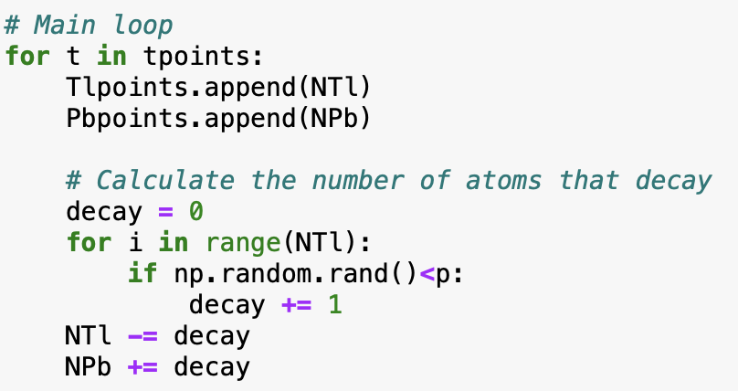
Simulation example: Radioactive decay
Example 10.1 from M. Newman, Computational Physics
Some physical processes are truly random (recall quantum mechanics), for instance radioactive decay
The number of radioactive isotopes with a half-life of $τ$ evolves as
therefore, the probability for a single atom to decay over the time interval t is
Let us simulate the time evolution for a sample of thallium atoms decaying (half-life of $τ$= 3.053 mins) into lead atoms.

Slide 13
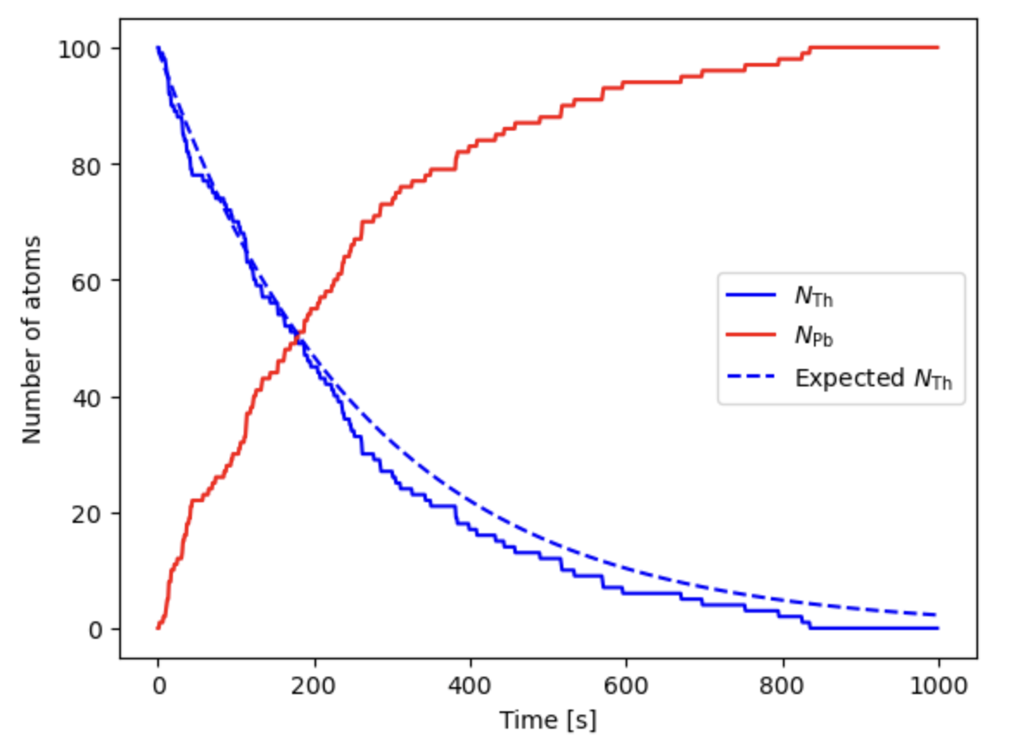
Simulation example: Radioactive decay
Expected:

Slide 14
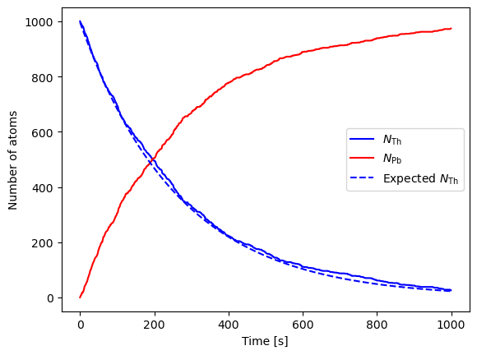
Simulation example: Radioactive decay
Expected:

Slide 15
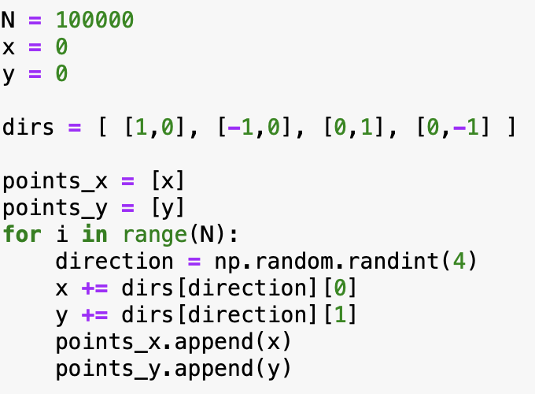
Simulation example: Brownian motion
Brownian motion is a motion of a heavy particle in a gas colliding with the lighter gas particles.
We can consider a simplified 2D motion of particle by randomly making
a small step at each iteration in one of the four directions.

Slide 16
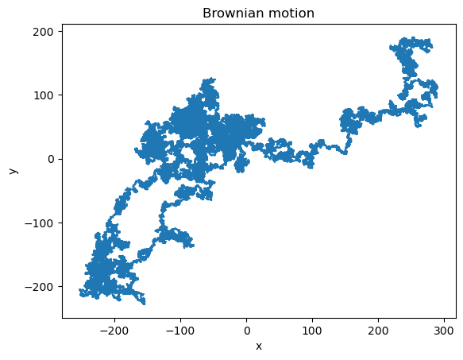
Simulation example: Brownian motion
Brownian motion is a motion of a heavy particle in a gas colliding with the lighter gas particles.
We can consider a simplified 2D motion of particle by randomly making
a small step at each iteration in one of the four directions.

Slide 17
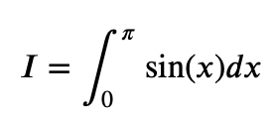
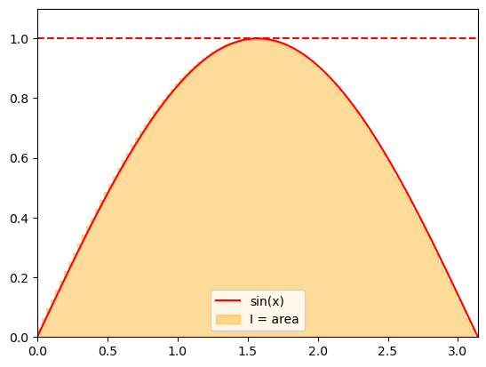
Computing integrals: Estimating the area under the curve
Recall the interpretation of a definite integral as the area under the curve.
We can use this interpretation to apply random numbers for approximating integrals.
Consider

Slide 18
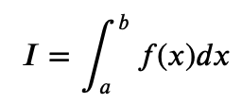
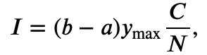
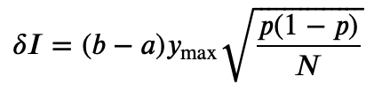
Computing integrals: Estimating the area under the curve
We can estimate the area by sampling the points uniformly from an enveloping rectangle and counting the
fraction of points under the curve given by the integrand f(x).
Assuming an integral
where f(x) > 0 and f(x) < y_{max}, the integrand can be evaluated as
where C is the number of the sampled points that fall under f(x).
The statistical error of the integrand can be estimated using the properties of the binomial distribution
with p = C/N:
The error scales with N^{-1/2}
To reduce the error by factor x2 we need to sample x4 more numbers – true for most Monte Carlo methods.

Slide 19
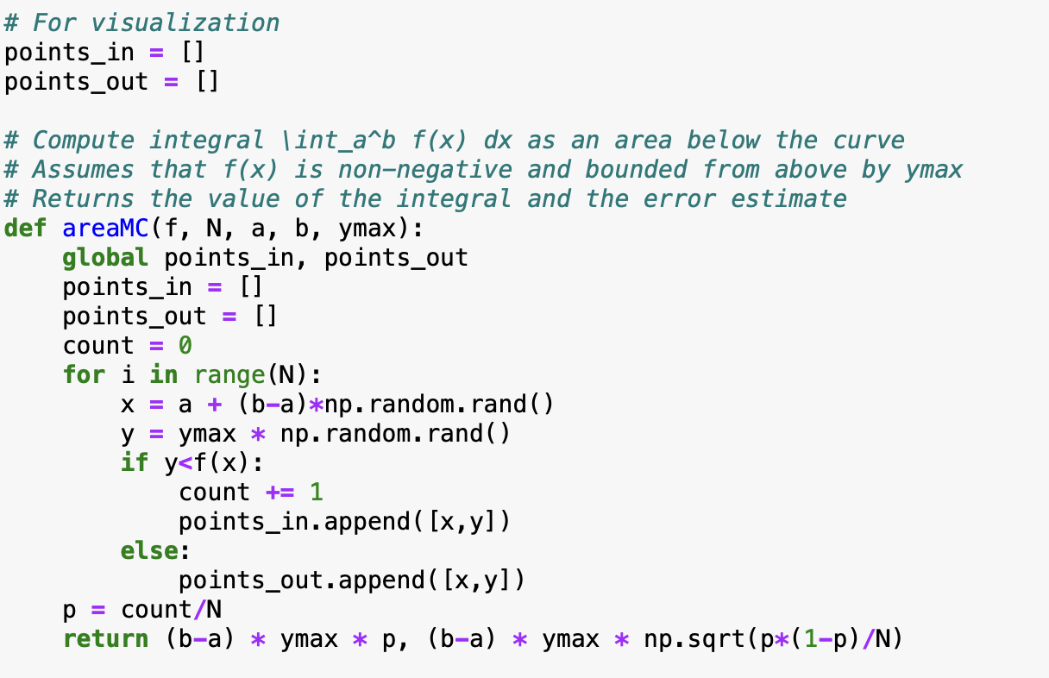
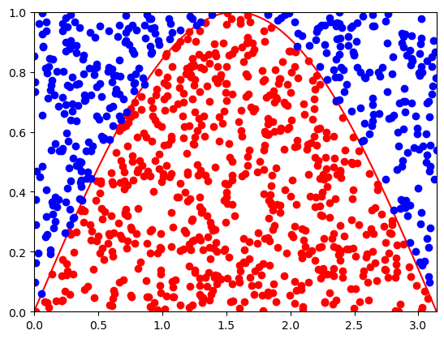
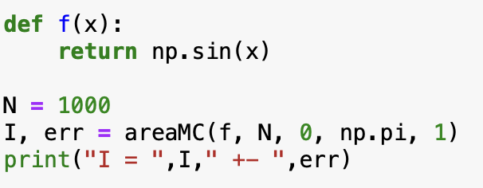
Computing integrals: Estimating the area under the curve

Slide 20
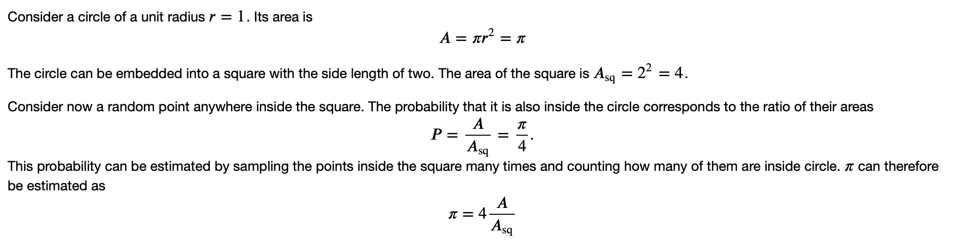
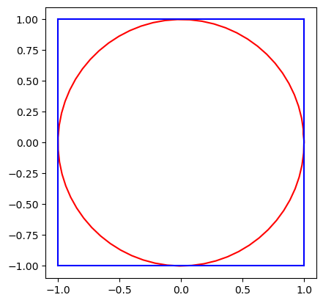
Computing pi

Slide 21
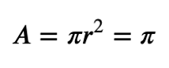
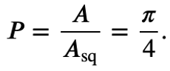
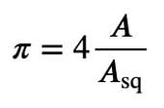

Computing $π$
Consider a circle of unit radius r = 1. Its area is:
The circle can be embedded into a square with a side length of two. The area of the square is: A_{sq} = 2² = 4
Consider now a random point anywhere inside the square. The probability that it is also inside the circle is the ratio of their areas:
This probability can be estimated by sampling points inside the square many times and counting how many fall inside the circle. $π$ can therefore be estimated as:

Slide 22
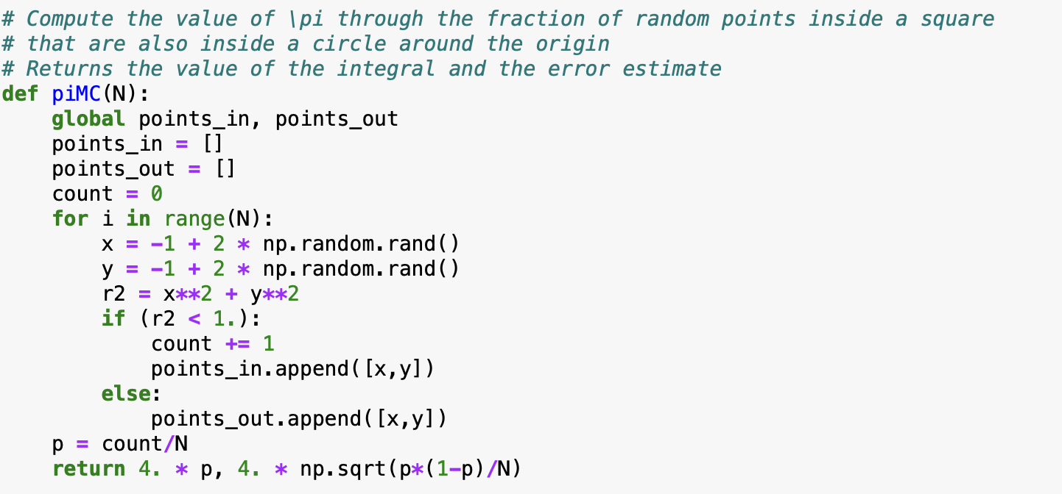
Computing $π$
Consider a circle of unit radius r = 1. Its area is:
The circle can be embedded into a square with a side length of two. The area of the square is: A_{sq} = 2² = 4
Consider now a random point anywhere inside the square. The probability that it is also inside the circle is the ratio of their areas:
This probability can be estimated by sampling points inside the square many times and counting how many fall inside the circle. $π$ can therefore be estimated as:
This method is known as the Monte Carlo estimation of π.

Slide 23
Computing pi

Slide 24
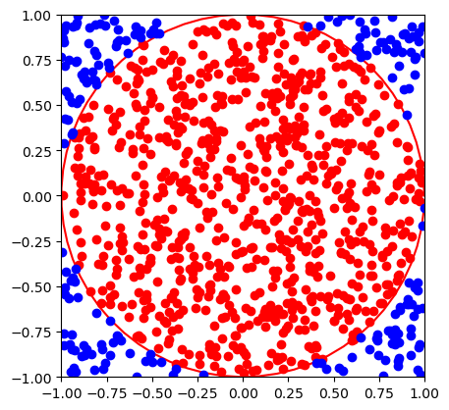
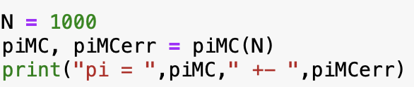
Computing pi
Try a larger number of points

Slide 25
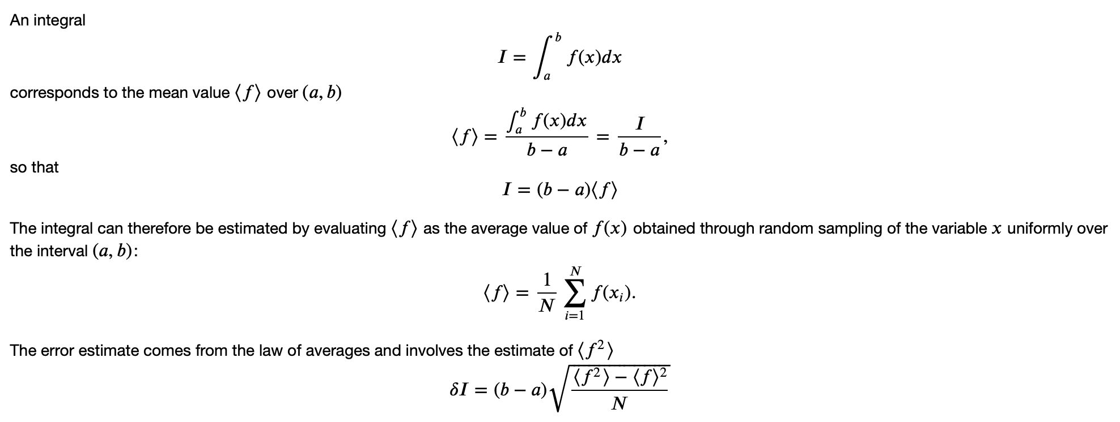
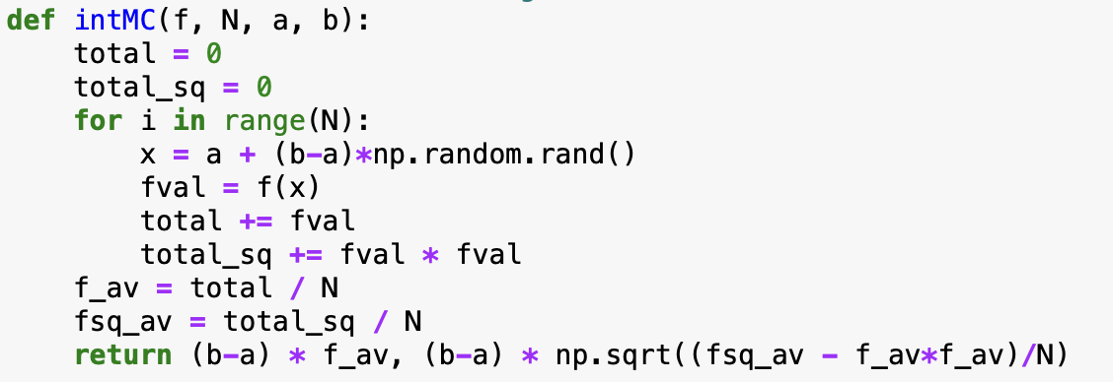
Computing integral as the average

Slide 26
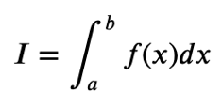
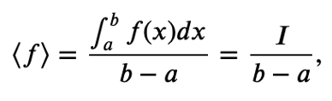
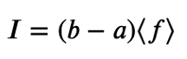
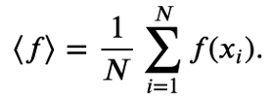
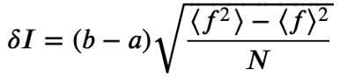
Computing integral as the average
The integral of a function over an interval (a, b) is given by:
The mean value of f(x) over (a, b) is:
which gives:
The integral can be estimated by computing the average value of f(x), where x is randomly sampled over (a, b):
Using the law of averages, the error estimate involves the variance of f(x):

Slide 27
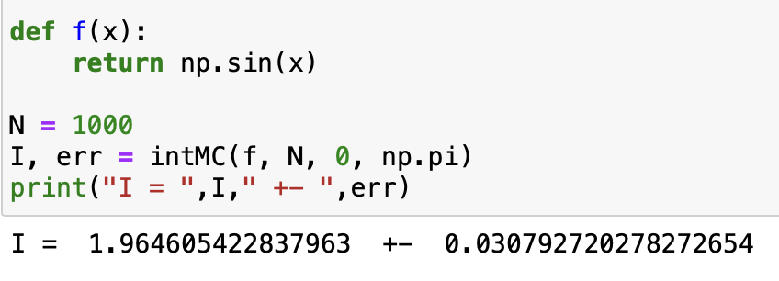
Computing integral as the average
Advantages:
the method works also if f(x) is negative
no need to know its maximum value

Slide 28
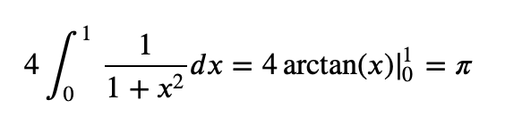
Another way to compute pi
Consider an integral

Slide 29
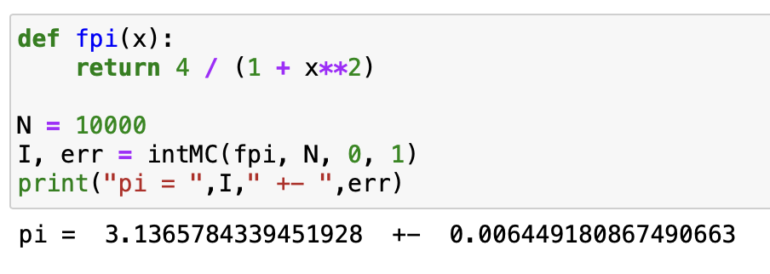
Another way to compute pi
Consider an integral

Slide 30
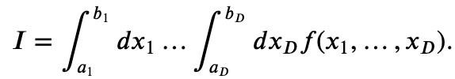
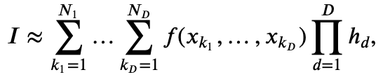
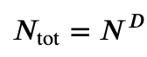

Computing multi-dimensional integrals
Monte Carlo methods really shine when it comes to numerical evaluation of integrals in multiple dimensions.
Consider the following D-dimensional integral
Computing it numerically using for instance the rectangle rule would involve the evaluation of a multi-dimensional sum
where
The total number of integrand evaluations is $N_{tot}=\prod_{d=1}^{N_{D}}{N_{d}}$,
e.g. if we use the same number N of points in each dimension, $N_{tot}$ scales exponentially with D
curse of dimensionality

Slide 31


Computing multi-dimensional integrals: Monte Carlo
Similar to 1D case, replace
by the mean
Here x₁,…,x_{D} are independent random variables distributed uniformly in intervals x_{k} in [a_{k},b_{k}].
Error estimate:
Increasing the number of dimensions by one: sample one more number each iteration.
linear complexity in D

Slide 32

Computing multi-dimensional integrals: Monte Carlo
Implementation:

Slide 33



Computing multi-dimensional integrals: Monte Carlo
Our example:
Analytic result:

Slide 34





Volume of a D-dimensional ball (hypersphere)
Let us consider an D-dimensional ball of radius R.
Its volume is given by a D-dimensional integral
This can be written with the recursion formula
with $V_{0}\left(R\right)=1.$
Rectangle (non-MC) method (recursive)

Slide 35


Volume of a D-dimensional ball (hypersphere)
Monte Carlo approach:
Observe that the ball $\sqrt{x_{1}^{2}+…+x_{D}^{2}}<R$ is a subvolume of a hypercube $−R<x_{1},…,x_{D}<R.$
If we now randomly sample points that are uniformly distributed inside the hypercube,
the fraction C/N of those that are also inside the ball will reflect
the ratio of the ball and hypercube volumes $V_{D}(R)$ and $V_{cube}\left(R\right)={(2R)}^{D}$
Therefore,

Slide 36


Volume of a D-dimensional ball (hypersphere)

Slide 37

Nonuniformly distributed random numbers
In many cases we deal with random numbers $ξ$ that are distributed non-uniformly.
Common examples are:
There are two common methods for generating nonuniform random variates. They both make use of uniformly distributed variates.
Inverse transform sampling
Rejection sampling

Slide 38


Inverse transform sampling

Slide 39

Inverse transform sampling

Slide 40


Inverse transform sampling
The algorithm follows these steps:
1. Calculate the cumulative distribution function (CDF)
2. Find the inverse function G⁻¹(y) as the solution to the equation
3. Sample uniformly distributed random variables $η$ and compute $ξ$ using the inverse function:
Challenges: Sometimes, evaluating G(x) and/or G⁻¹(y) explicitly is difficult. In such cases, numerical integration and/or non-linear equation solvers may be required.

Slide 41




Inverse transform sampling: Exponential distribution
Example: Exponential Distribution
1. Recall the radioactive decay process. The time of decay is distributed according to the probability density function:
2. The cumulative distribution function is given by:
3. To apply inverse transform sampling, we need to invert F(x) by solving:
4. Solving for t, we obtain:

Slide 42

Inverse transform sampling

Slide 43


Sampling radioactive decay time

Slide 44


Sampling points inside a circle

Slide 45

Sampling points inside a circle
One way to sample points inside a unit circle is by switching to polar coordinates:
where we sample r $∈$[0,1) and $φ∈\text{[0, 2}π\text{)}.$
Naively, one could sample r and $φ$ independently from two uniform distributions. Let’s see what happens!

Slide 46

Sampling points inside a circle
One way to sample points inside a unit circle is by switching to polar coordinates:
where we sample r $∈$[0,1) and $φ∈\text{[0, 2}π\text{)}.$
Naively, one could sample r and $φ$ independently from two uniform distributions. Let’s see what happens!
The points clump more in the center!

Slide 47
Sampling points inside a circle
The points clump more in the center!

Slide 48

Sampling points inside a circle

Slide 49




Sampling points inside a circle
The points clump more in the center because r is not uniformly distributed.
Recall the differential area element in polar coordinates:
This leads to the probability density functions:
Cumulative Distribution Function (CDF)
To obtain a properly distributed r, we solve $F_{r}\left(r\right)=η$ which gives:
$$r=\sqrt{η}$$

Slide 50



Sampling points inside a circle
The points clump more in the center because r is not uniformly distributed.
Recall the differential area element in polar coordinates:
This leads to the probability density functions:
Cumulative Distribution Function (CDF)
To obtain a properly distributed r, we solve $F_{r}\left(r\right)=η$ which gives:
$$r=\sqrt{η}$$

Slide 51
Sampling points inside a circle

Slide 52




Sampling of an Isotropic Direction in 3D
One common problem in Monte Carlo simulations is the random sampling of an isotropic direction in 3D space. This issue arises in various contexts, such as:
• Sampling a random orientation of an axially symmetric object (e.g., a rod).
• Sampling the momentum direction of a particle.
This problem is equivalent to choosing a random point on a unit sphere. The coordinates x, y, z on the sphere can be parametrized using azimuthal and polar angles:
• $φ∈[0, 2π)$ (azimuthal angle)
• $θ∈[0, π)$ (polar angle)
Using these angles, the Cartesian coordinates are given by:
$$x=\sin{θ}\cos{φ}$$
$$y=\sin{θ}\sin{φ}$$
$$z=\cos{θ}$$

Slide 53









Sampling of an Isotropic Direction in 3D
$$x=\sin{θ}\cos{φ}$$
$$y=\sin{θ}\sin{φ}$$
$$z=\cos{θ}$$
The solid angle element is:
The random variables $φ$ and $θ$are independent.
$φ$is uniformly distributed in [0, 2$π$], making its sampling straightforward.
However, $θ$has a weighted probability density function:
The cumulative distribution function is:
In practice, work directly with $\cos{θ}$ and $\sin{θ:}$
Solving $F_{θ}\left(θ\right)=η$, we obtain:

Slide 54

Sampling an isotropic direction

Slide 55


Sampling an isotropic direction

Slide 56


Sampling normally distributed variables

Slide 57



Sampling normally distributed variables
One of the most common probability distributions is the normal (or Gaussian) distribution, given by:
There are many standard methods for sampling from this distribution. One common approach is to standardize the variable by making the transformation $x→μ+σx$
After this transformation, the new variable follows a standard normal distribution with zero mean and unit standard deviation:
Calculating the cumulative distribution function $F\left(x\right)=\int_{−∞}^{x}{ρ\left(x^{′}\right)dx′}$ is not straightforward, use numerical methods.

Slide 58

Sampling normally distributed variables

Slide 59


Sampling normally distributed variables

Slide 60






Rejection sampling
The rejection sampling method allows one to sample a variable $ξ$from an envelope distribution and accept or reject it with a certain probability.
Consider again the probability density function for the polar angle:
Since $ρ_{θ}$ is bounded from above, we define:
1. Sample a candidate value $θ_{cand}$from a uniform distribution over (0, $π$).
2. Accept $θ_{cand}$with probability:
3. This step can be performed by sampling y from a uniform distribution over (0, $ρ_{θ}^{max}$) and accepting $θ_{cand}$ if $y < ρ_{θ}(θ_{cand})$
Geometric Interpretation: If we consider $θ_{cand}=x$ and y as the coordinates of a point in a plane, we accept $θ_{cand}$if it lies below the curve defined by $ρ_{θ}\left(θ\right)$. This ensures that $θ_{cand}$values are accepted at a rate proportional to $ρ_{θ}\left(θ\right)$, as desired.
Advantages of Rejection Sampling:
$ρ_{θ}\left(θ\right)$does not need to be a normalized distribution for the method to work.

Slide 61


Rejection sampling

Slide 62


Rejection sampling

Slide 63

Pros and Cons of Rejection Sampling
Pros:
• Does not require the distribution to be normalized.
• Works even if y_{max} is larger than the true maximum of $ρ(x)$
• Applicable to generic distributions and does not require the evaluation of the cumulative distribution function.
Cons:
• Can be inefficient if the rejection rate is high (e.g., for highly peaked distributions).
• Not directly applicable to distributions over infinite ranges.
Generalizations of Rejection Sampling
To address some of its limitations, several generalizations of rejection sampling can be used, including:
• Adaptive rejection sampling by considering multiple enveloping rectangles.
• Variable transformation to map an infinite interval into a finite one.
• Sampling from a non-uniform enveloping distribution for better efficiency.

Slide 64

Rejection sampling

Slide 65







Importance sampling
Recall the calculation of an integral as statistical average
where
Some issues with the method:
Sample unimportant regions (e.g. f is highly peaked)
Integrable singularities
Importance sampling:
Sample $x_{i}$ from a non-uniform distribution w(x) that resembles f(x).
The integrand is then calculated as
Normalization:
Error:

Slide 66

Importance sampling
For w(x)=1/(b-a) we recover the mean value method
For w(x) $∝$ f(x) one has $\left\langle \frac{f(x)}{w(x)}\right\rangle$ = const = I and $δI=0$

Slide 67

Importance sampling

Slide 68


Importance sampling: Example
Integrable singularity at x=0

Slide 69








Importance sampling: Example
Mean value method
Importance sampling
f(x)/w(x)
Statistical error is more than x10 smaller than in the mean value method.
We would need more than x100 samples in the mean value method to reach the same accuracy as importance sampling in this case.

